Slide 1
6- Python Extension

Slide 2
context
“python” extension in VSCode 3
Features in “python” extension: 4
Linting
Debuging
Autocompletion
Formatting
Testing
Code Snippets
Extension tab 5
Install “python” extension 6
Python environment 10
Install “Linter Pylint” 12

Slide 3
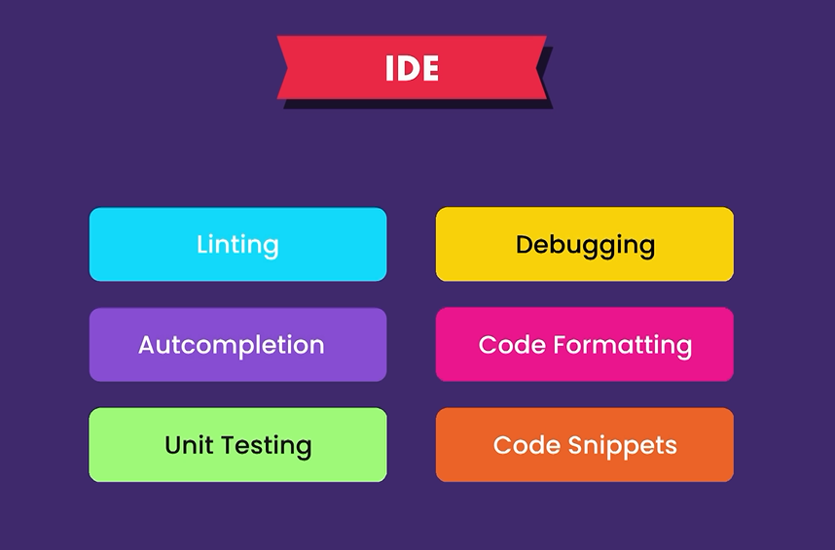
"python" extension in VSCode
how to convert vs code to a powerful IDE by using an extension called python.

Slide 4
Features in “python” extension/plug in
Linting: analyzing our code for potential errors.
Debugging: involves finding and fixing errors.
Autocompletion: helps us write code faster so we don't have to type every character
Formatting: making our code clean and readable just like how we format our articles, newspapers, books to make them clean and readable
Testing: involves writing a bunch of tests for our code, we can run these tests in an automated fashion to make sure our code is behaving correctly
Code Snippets: reusable code blocks that we can quickly generate so we don't need to type them all by hand.

Slide 5
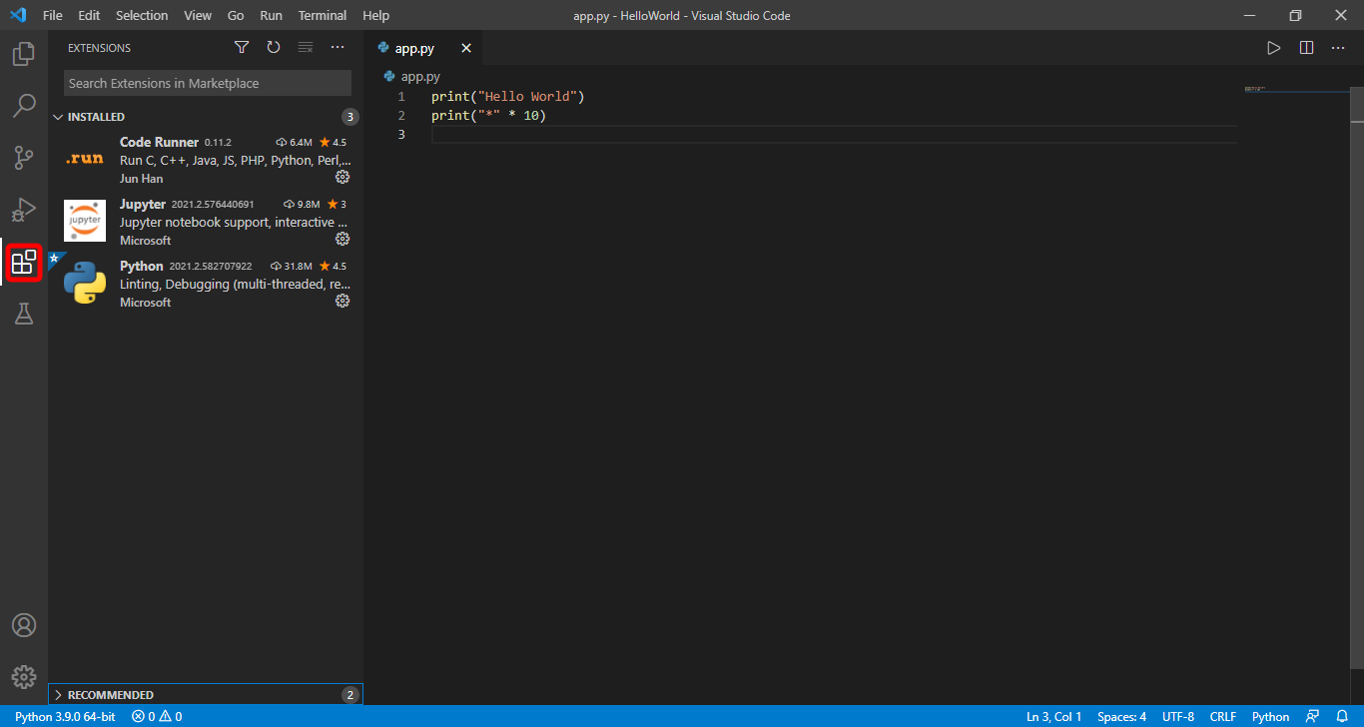
Extension tab in VSCode
This icon opens the extensions tab.

Slide 6
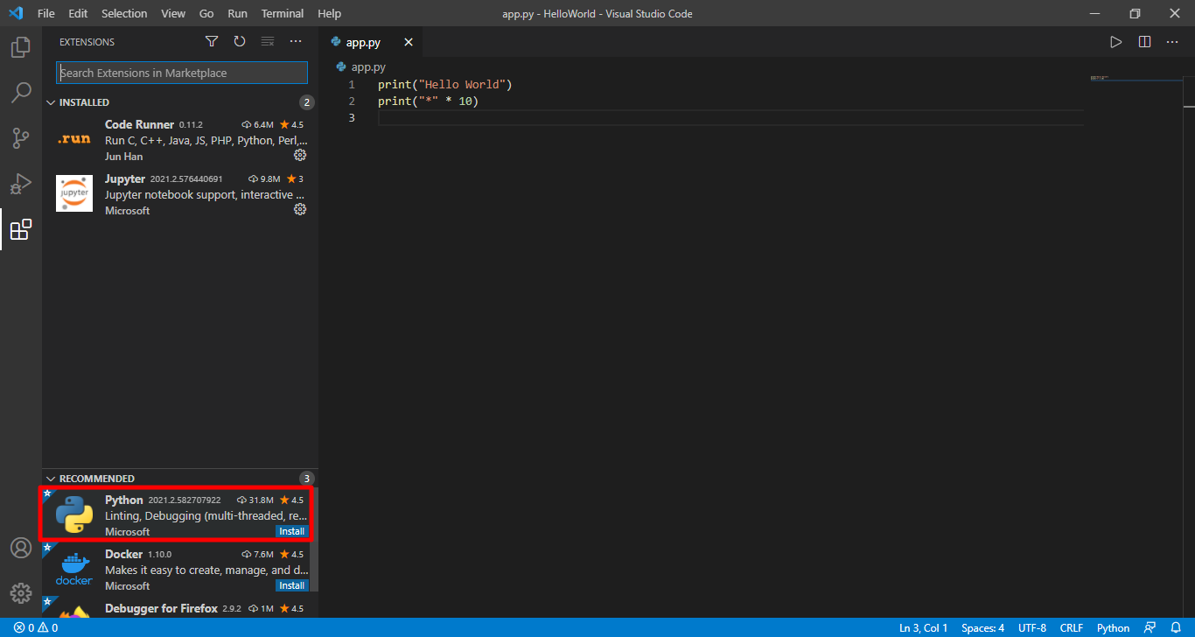
Install “python” extension
under the recommended tab you can see the python extension,
if you don't see this, simply type python here on the top

Slide 7
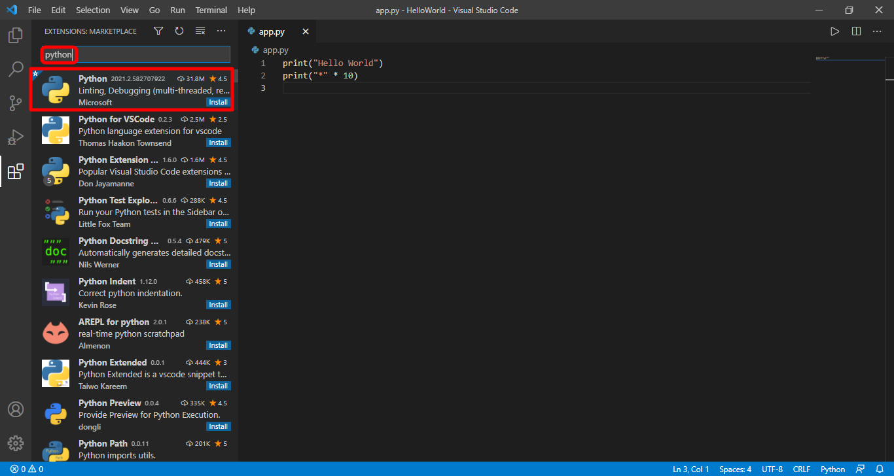
Install “python” extension (cont.)
Search “python”

Slide 8
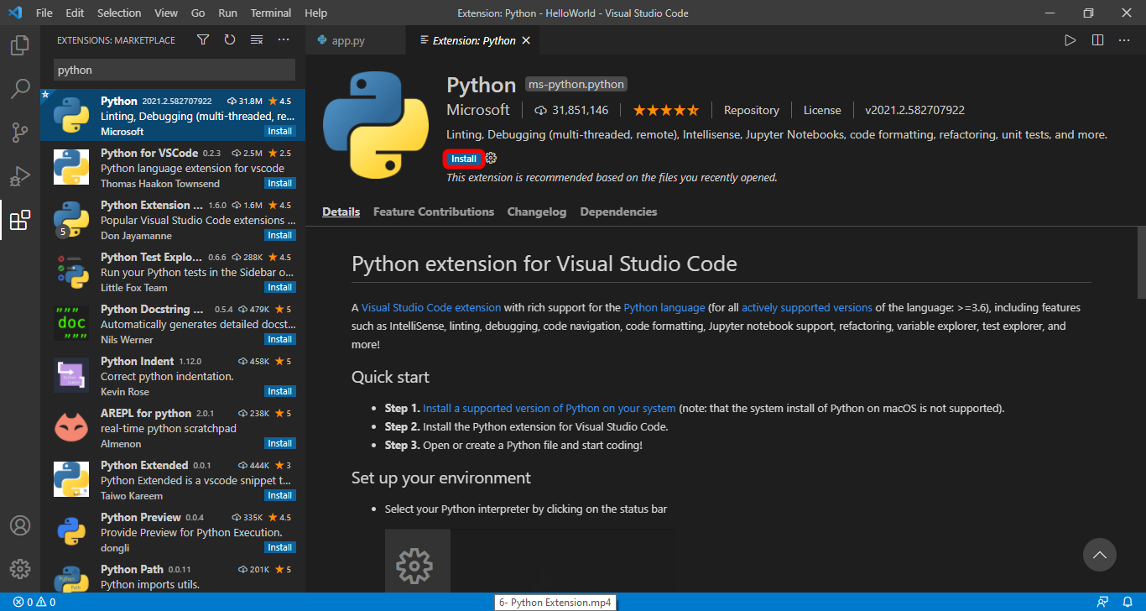
Install “python” extension (cont.)
Click on the desired result
Install it
then you will have to reload vs code.
Click on reload button or if it’s not appeared close and open it again

Slide 9

Then you see this message.
Don’t close it.
We talk about it a little bit later.

Slide 10
Now to do this first we need to change our python environment. So if you look here on the bottom left corner you can see the current python that is used in vs code.

Slide 11
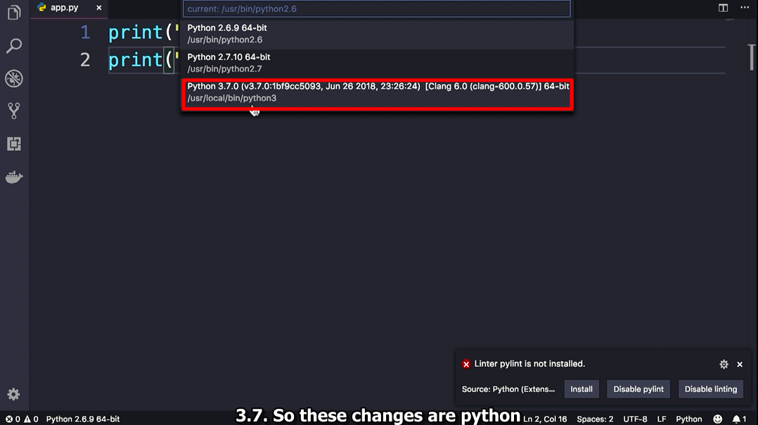
Chances are you see a different version here,
so click here, and in this list make sure to select python 3.7. So these changes are python environment 3.7 and

Slide 12
Install “Linter Pylint”
Linter is a program or a tool that analyzes our code and finds potential problems(errors) in our code.
for python, there are several linters out there.
Pylint is one of the most popular ones, that this python extension uses by default.
So we need to go ahead and install pylint as well.

Slide 13

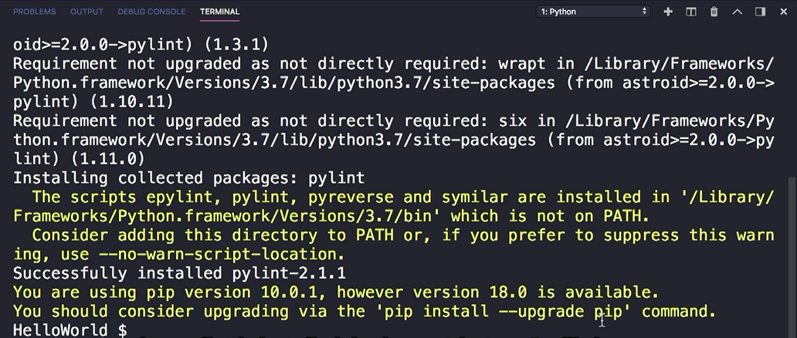
Install “Linter Pylint” (cont.)
then we can install Pylint by clicking this button

